Slide 1

DS105 Project outcome on logistics industry
Presented By: Daniel Tan

Slide 2

Contents
Current Problem
Aim, Rationale and chosen Machine Learning model
First glance of the Dataset
Exploratory Data Analysis
Regression ML Training & Prediction
Dummy & Scaling
PyCaret (Regression)
Gradient Boosting Regressor (Predictions)
Classification ML Training & Prediction
Scaling & SMOTE
PyCaret (Classification)
Light Gradient Boosting Machine (Predictions)
Conclusion
Limitations and Takeaways

Slide 3


current problem
A Logistics company is trying to determine which products to continue selling, and which products to remove from their inventory.

Slide 4


Aim, Rationale and chosen machine learning (ML) model
Aim: Determine which product(s) to continue stocking based on the sales within the past 6 months.
Rationale: Reason is to maximise the spatial value of the inventory warehouse.
Chosen ML model: Supervised Regressor

Slide 5






first glance of the Dataset
Original
Active Inventory SKU Products
Historical
SKU products
Historical
Active Inventory
Common overlapping years were 2000 – 2017 after listing them out.
Products release year:
Historical dataset = 1935 to 2017*
Active Inventory = 1900 to 2018*
*Caveat: Not in consecutive order
Use unique SKU Numbers from both datasets for train and testing of ML model.
Dataset shape (To Be Pre-processed using merge inner join)
Dataset shapes:
Original dataset =
198917 rows, 14 columns
Historical dataset =
75996 rows, 14 columns
Active Inventory dataset =
122921 rows, 14 columns

Slide 6
Exploratory data analysis
Features
SKU_number | Unique identifier for each product (198 917 products)
PriceReg | Product Price
File_Type | Historical sales or Active Inventory
Release_Year | Year which Product release
ItemCount | Quantity of Items left in Inventory
MarketingType | S = Smarketing (method that fuses sales and marketing) D = Direct marketing (e.g. marketing towards end consumers)
ReleaseNumber | Number of version/iterations the product has had
Labels
Sold_Count | Units sold for that product
SoldFlag | 1 = product sold within 6 months 0 = product was not sold within 6 months
Data.shape = (198917, 14)
*Discarded features: “LowUserPrice”, “LowNetPrice” and “StrengthFactor”

Slide 7
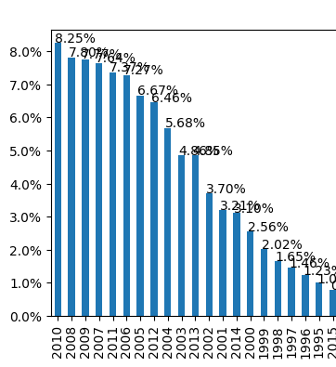
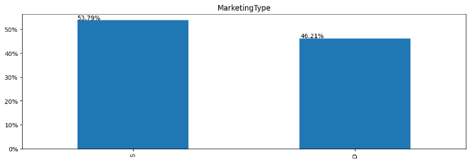
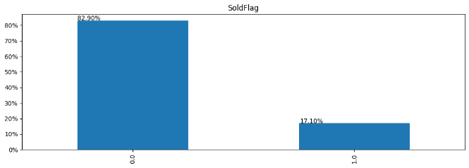
Exploratory Data Analysis (categorical data)
Release Year
Severely imbalanced
Notes:
Note:
- Top 3 years whereby products were released the most were in 2010 (8.25%), 2008 (7.80%), 2009 (7.77%)
- More products were marketed using the S-Marketing type (53.79%) compared to Direct marketing (46.21%)
- 17.1% of the products in historical data were sold within 6 months, the other 82.9% were either unsold or sold after a period of 6 months
(Oversampling method would be required before training Classification model, if label is SoldFlag)

Slide 8
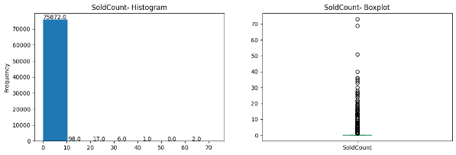
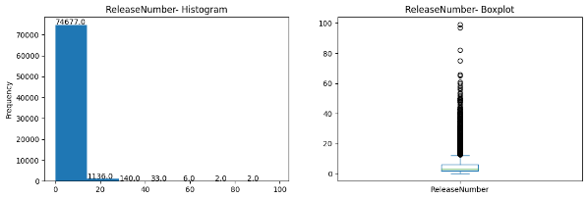
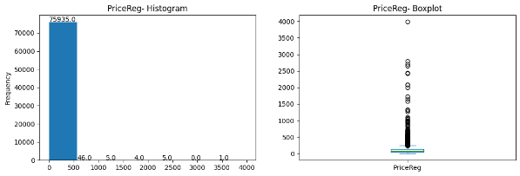
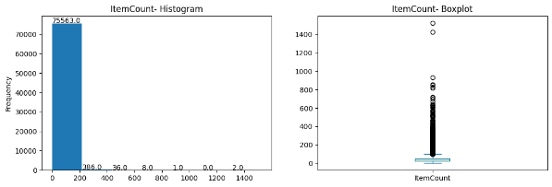
Exploratory Data Analysis (Numerical data)
Notes:
Note:
- Most of the products sold count is below 10 pieces
- Most of the products cost below USD600.00
- The company usually keeps about 200 pieces for each product in their warehouse regardless of the sold count
- Most of the products released had less than 15 versions

Slide 9
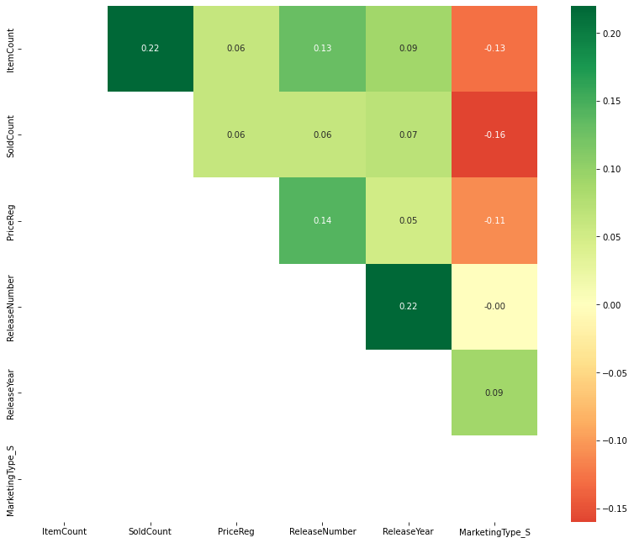
Exploratory Data Analysis (Correlation heatmap)
Positive Correlation Features:
Item count ⬄ Sold Count
Release Year ⬄ Release Number
Item count ⬄ Release Number
Price Reg ⬄ Release Number
Negative Correlational insights:
S-Marketing* ⬄ Sold Count
S-Marketing ⬄ Item Count
Notes:
Note:
Positive Correlational insights:
- Item count and Sold Count have the highest positive correlation -> If your product sells well, naturally you want to restock more.
- Release Year and Release Number have the highest positive correlation -> This can be explained as more releases means the released year would be very recent
- Item count and Release Number also have positive correlation -> If your product sells well, you would also want to provide more versions of it to cater to that target audience
- Price Reg and Release Number also have positive correlation -> If each version of the product is an improvement, naturally the cost from R&D will be added into its price
Negative Correlational insights:
- S-Marketing and Sold Count have the highest negative correlation → This could mean direct marketing is a better strategy, but the underlying reason is still unknown due to insufficient contextual information e.g. client type, how the sales were made, what kind of product is it, etc.
- S-Marketing and Item Count have negative correlation → This may require more contextual information, however if the item was directly marketed, more products quantities need to be stored in the inventory

Slide 10
Regression ML training & Prediction

Slide 11
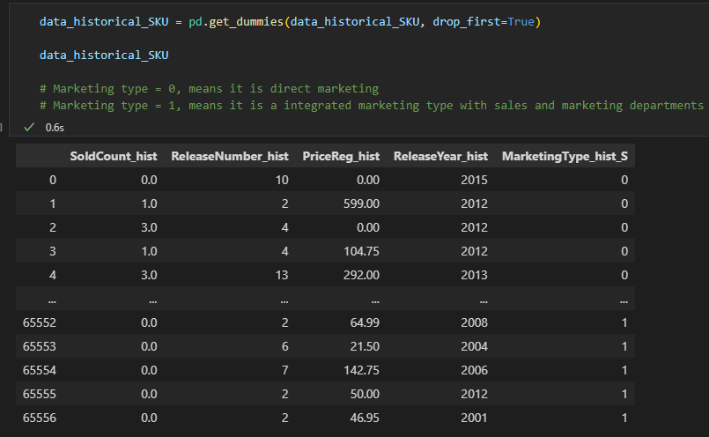
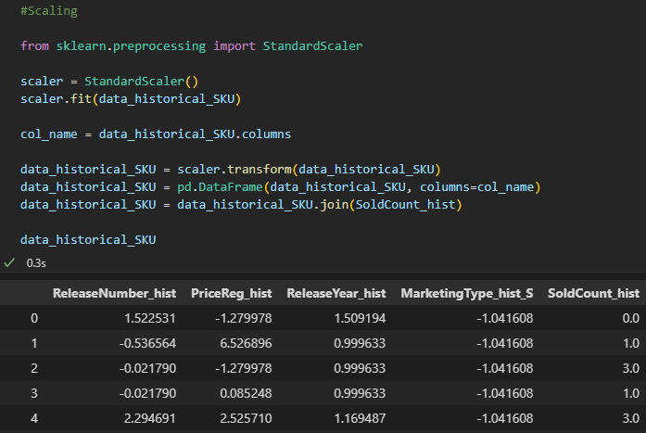
Dummy & Scaling for Regressor ml training
Dummy variables
Scaling

Slide 12
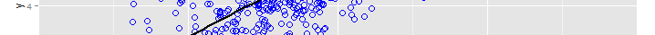
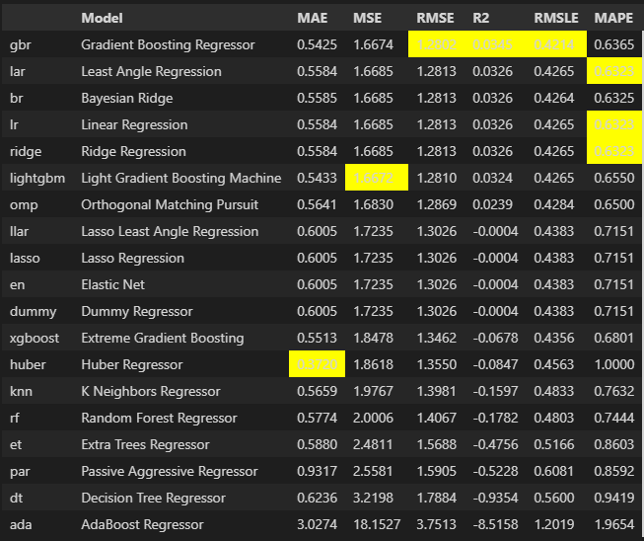
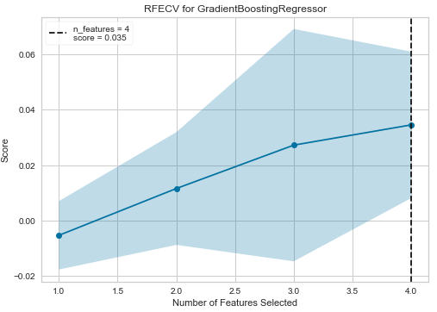
PyCaret (Regression)
Compare_models()
Evaluate_model(<insert best model>)
*Based on the poor R-squared score, and the high RMSE, I am changing from regression to classification;
But will try to tune the hyperparameters and use GB Regressor just to test out how badly it might look.

Slide 13
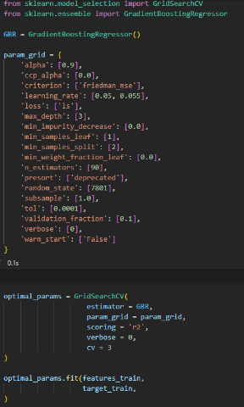
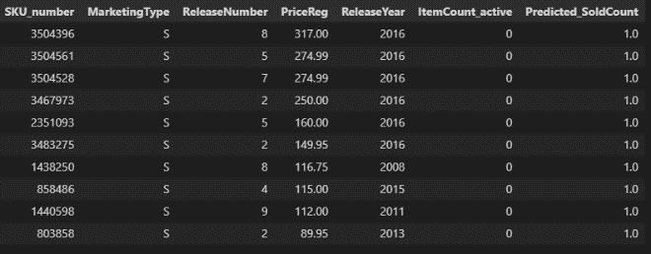
Gradient Boosting Regressor (predictions)
Predictions (ranked based on Price of product)
R2 score improved slightly from 0.0345 to 0.0506
Total of 30 products needs to be restocked based on the GB Regressor prediction.
Tuned with GridSearchCV
Learning rate = 0.05
max_depth = 3
n_estimators = 90
random_state = 7801
Notes:
Note:
R2 score improved slightly from 0.0345 to 0.0506

Slide 14
Classification ML Training & Prediction

Slide 15
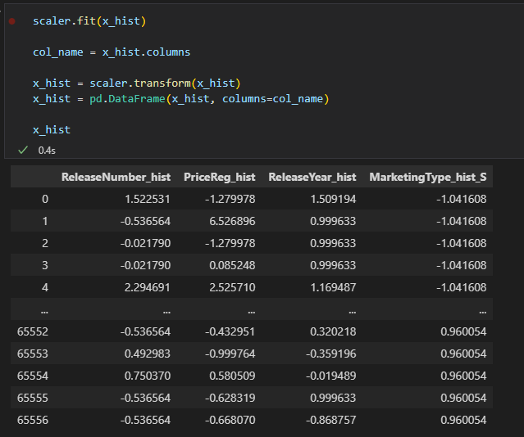
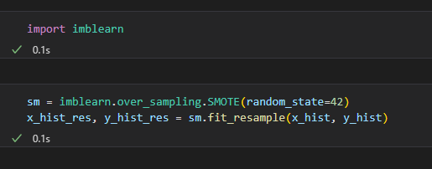
Scaling & SMOTE for classification ml training
Scaling
SMOTE

Slide 16
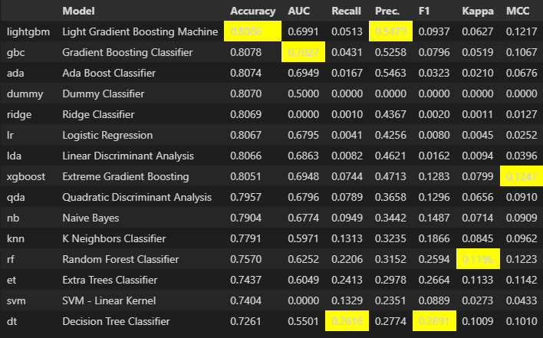
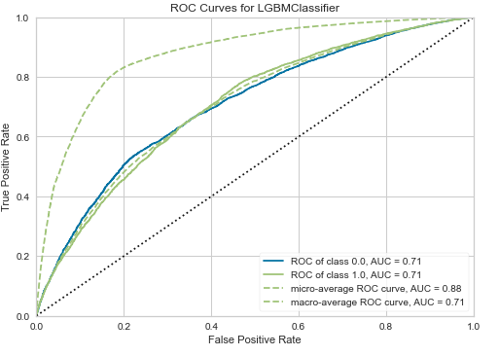
PyCaret (classification)
Compare_models()
Evaluate_model(<insert best model>)
Choice: Light GBM
Notes:
Note:
For this model we want to optimise inventory storage space, so we want higher Accuracy and Precision
Reason being, we have limited space and only want to buy and store stuff (True Positives) that have higher chance to sell (Predicted Positives),
Precision = Predicting the number of Positive cases correctly (TP / Predicted positives)

Slide 17
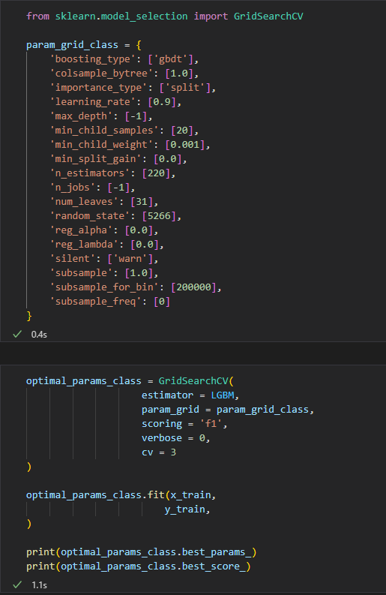
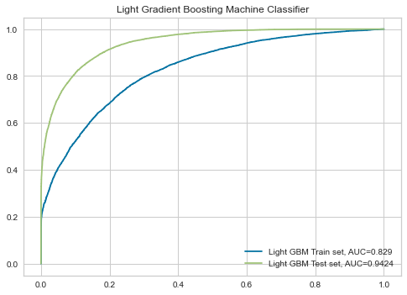
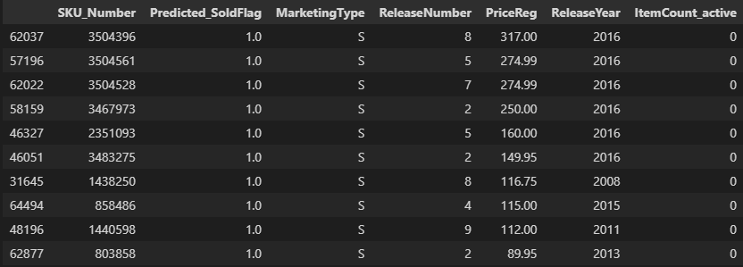
Light GBM Classification (predictions)
Predictions (ranked based on Price of product)
AUC score (train set) = 0.829
AUC score (test set) = 0.942
Total of 30 products needs to be restocked based on the Light GBM classification prediction.
Tuned with GridSearchCV:
Learning rate = 0.9
max_depth = -1
n_estimators = 220
random_state = 7801
Notes:
Note:

Slide 18

Conclusion
Based on the Light GBM classification model’s prediction:
There are 30 products that have high probability of being sold in the next 6 months.
These 30 products are out of stock in the current inventory and needs restocking.
By order of Price, the top 5 products cost at least USD160.00 and were released quite recently (2016).
Majority of the 30 products were S-Marketing types (28).
Earlier EDA shows S-Marketing and Soldcount have negative correlation.
Marketing and Sales might want to dive deeper on the S-Marketed strategies for these 28 products.

Slide 19
Limitations and takeaways
Notes:
Internal notes:

Slide 20







Limitations
Takeaways
Data dictionary regarding features
(such as Strength factor, Low User Price and Low Net Price)
More characteristics about each unique product
(e.g. category, brand, made in <country>, etc.)
Time series of sales across 6 months for more robust regressor model training
(how certain products or category of products would perform in the next quarter/3 months)
Multiple steps and adjustments to train and refine a machine learning model (but not all need to be used)
PyCaret is very useful
More to learn about evaluating models on PyCaret

Slide 21

Thank you
GitHub link
Notes:
Internal notes:

